Slide 1
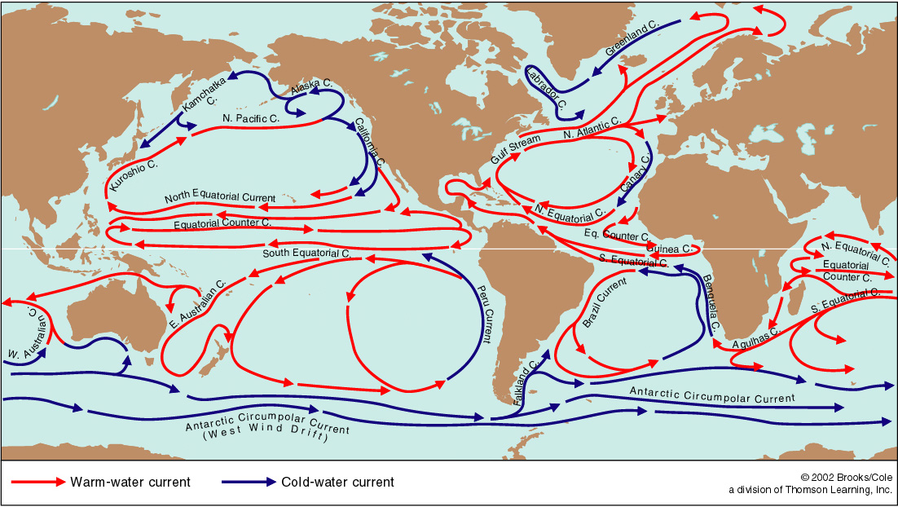
Global circulation and water masses
Summary of circulation
Summary of water masses
Meridional overturning and Global overturning

Slide 2
So how does it all flow?
The world’s oceans are composed of :
Gyres, western and eastern boundary currents, Antarctic Circumpolar Current, equatorial circulations
Wind Driven and Density Driven

Slide 3
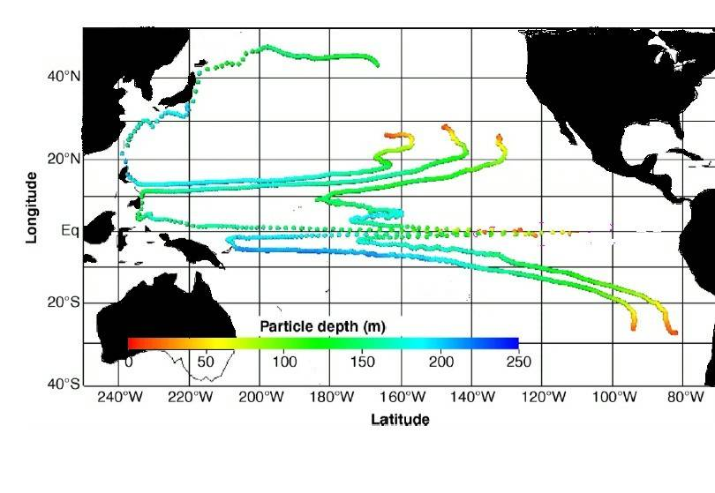
The Shallow, Swift Wind-driven Circulation

Slide 4
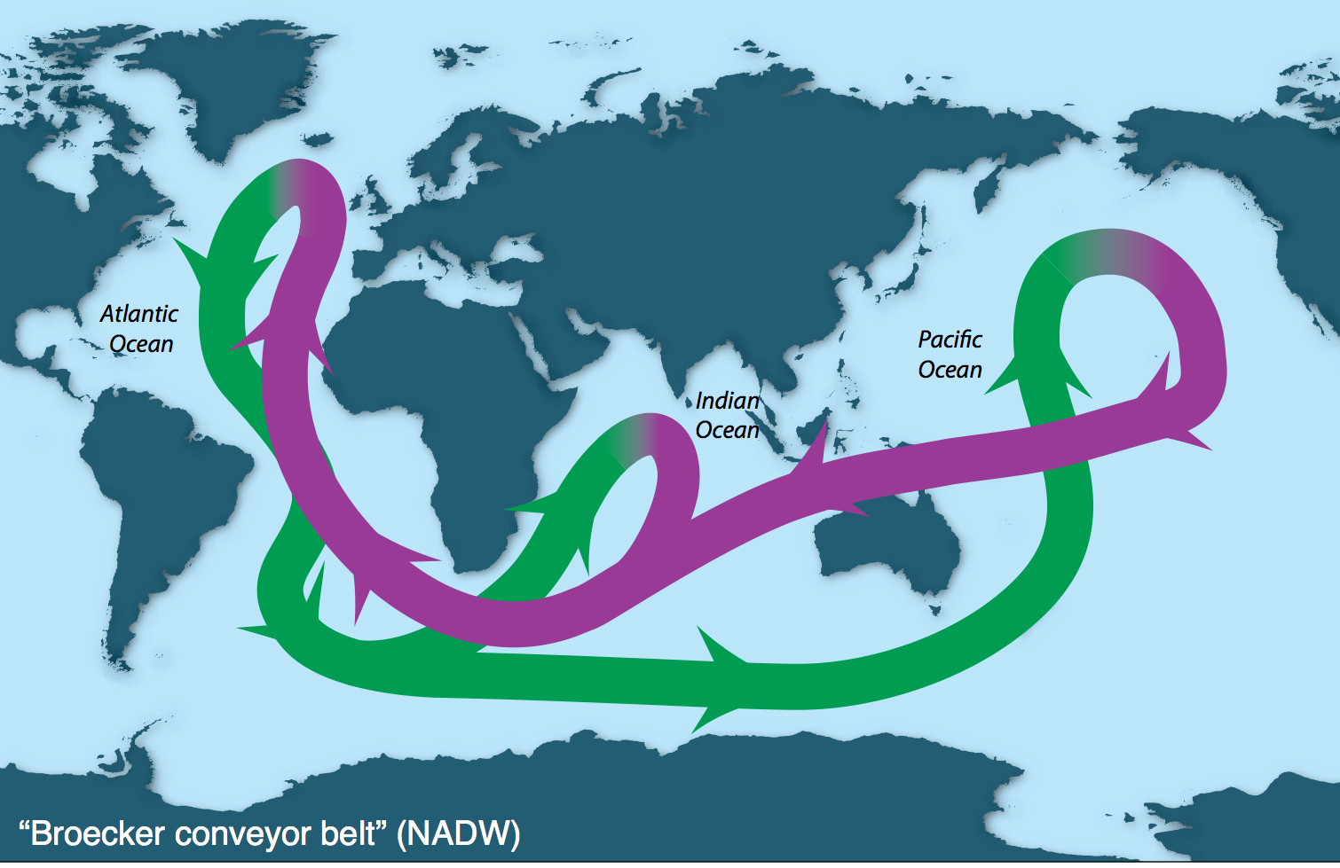
Schematics of the overturn: based on water mass concepts and quantitative estimates of overturning transport Broecker “conveyor belt”
The Slow, Deep Thermohaline Circulation
Simplification of NADW global overturning circulation ALONE

Slide 5
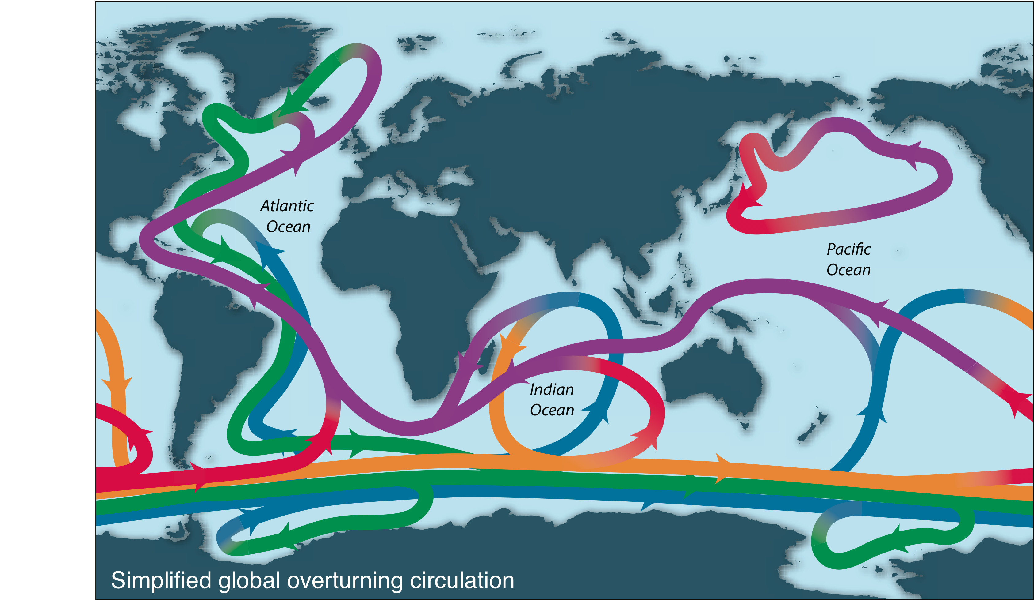
Global overturning schematic
More complete view based on major water mass transformations and quantitative overturning transports

Slide 6
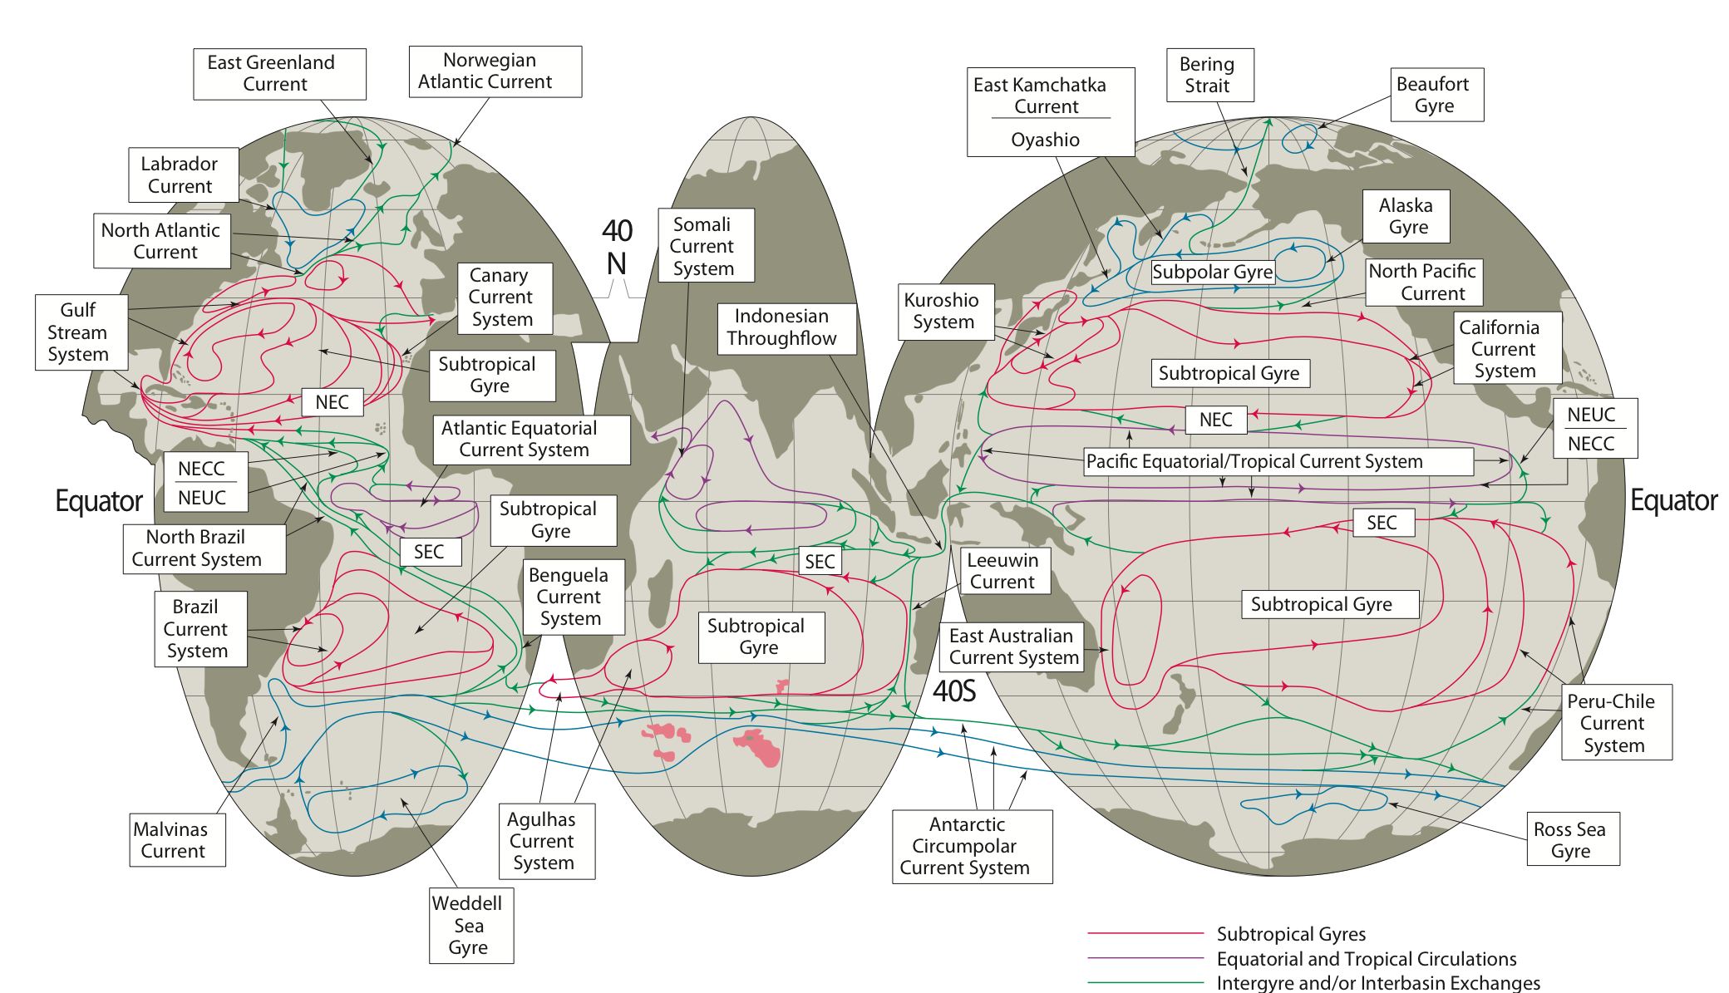
Upper ocean circulation
Notes:
Go back to typical structures lectures.

Slide 7
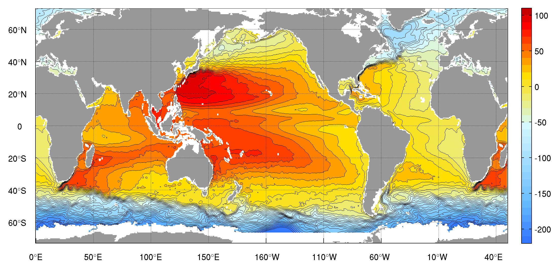
Absolute surface height, related to surface geostrophic velocity

Slide 8
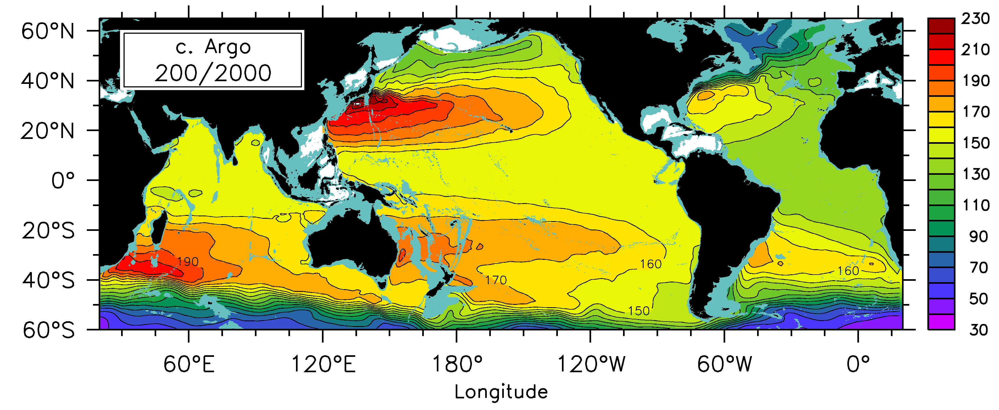
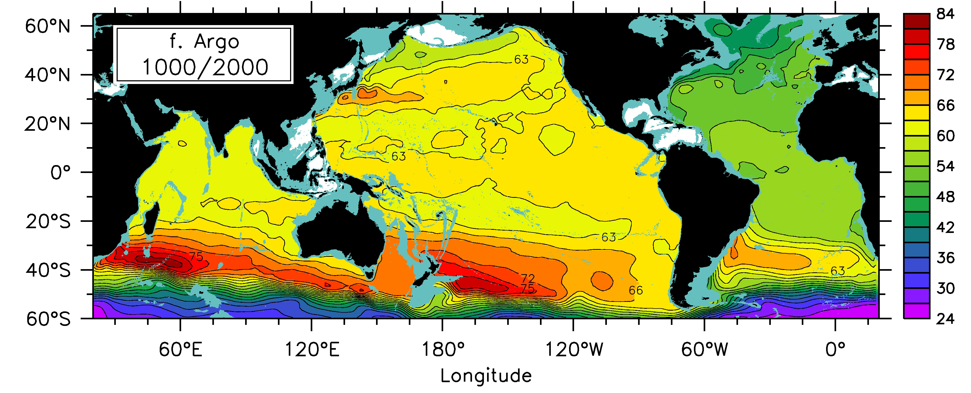
200 and 1000 dbar circulation rel. to 2000 dbar
Shrinkage of strong part of ST gyres to west and pole (into the WBC)

Slide 9
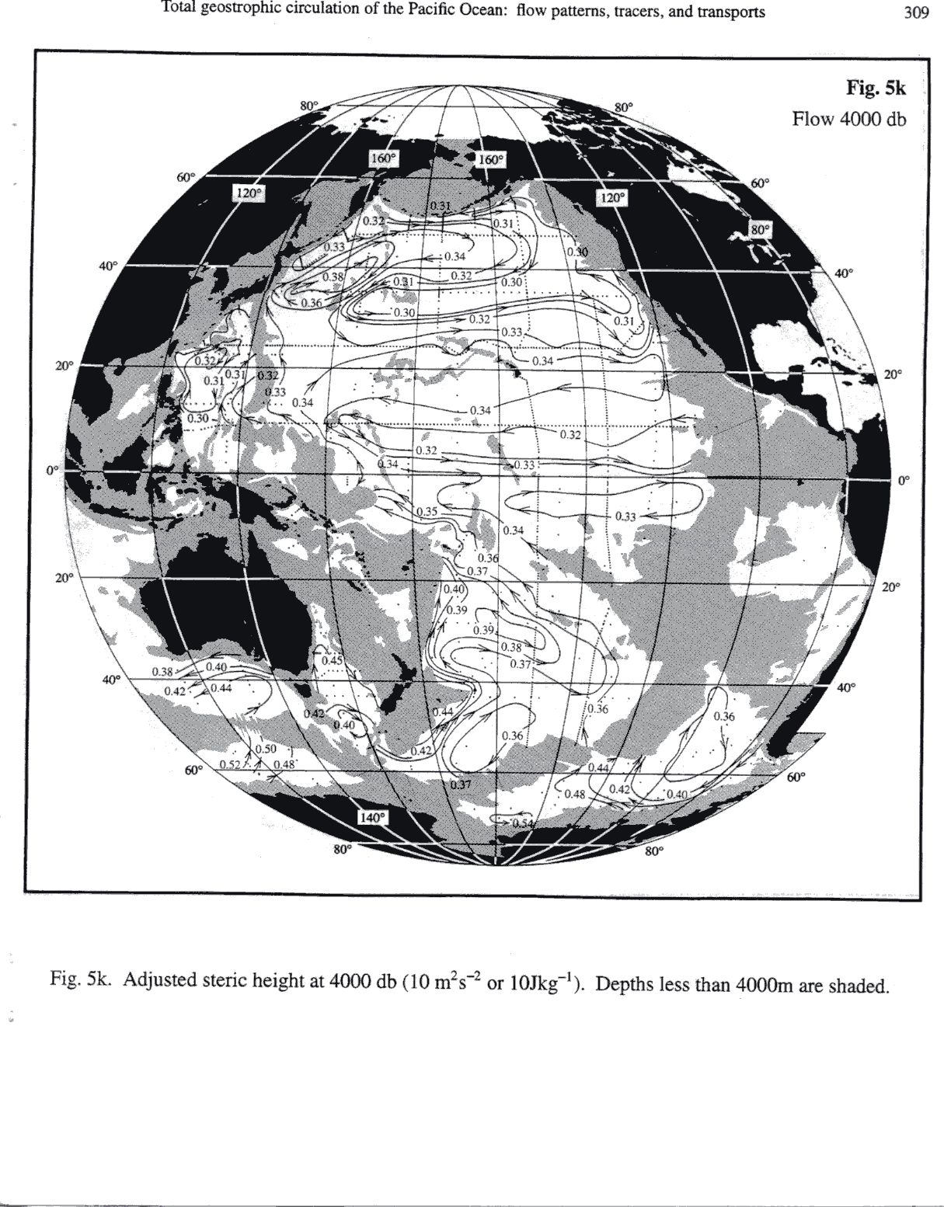
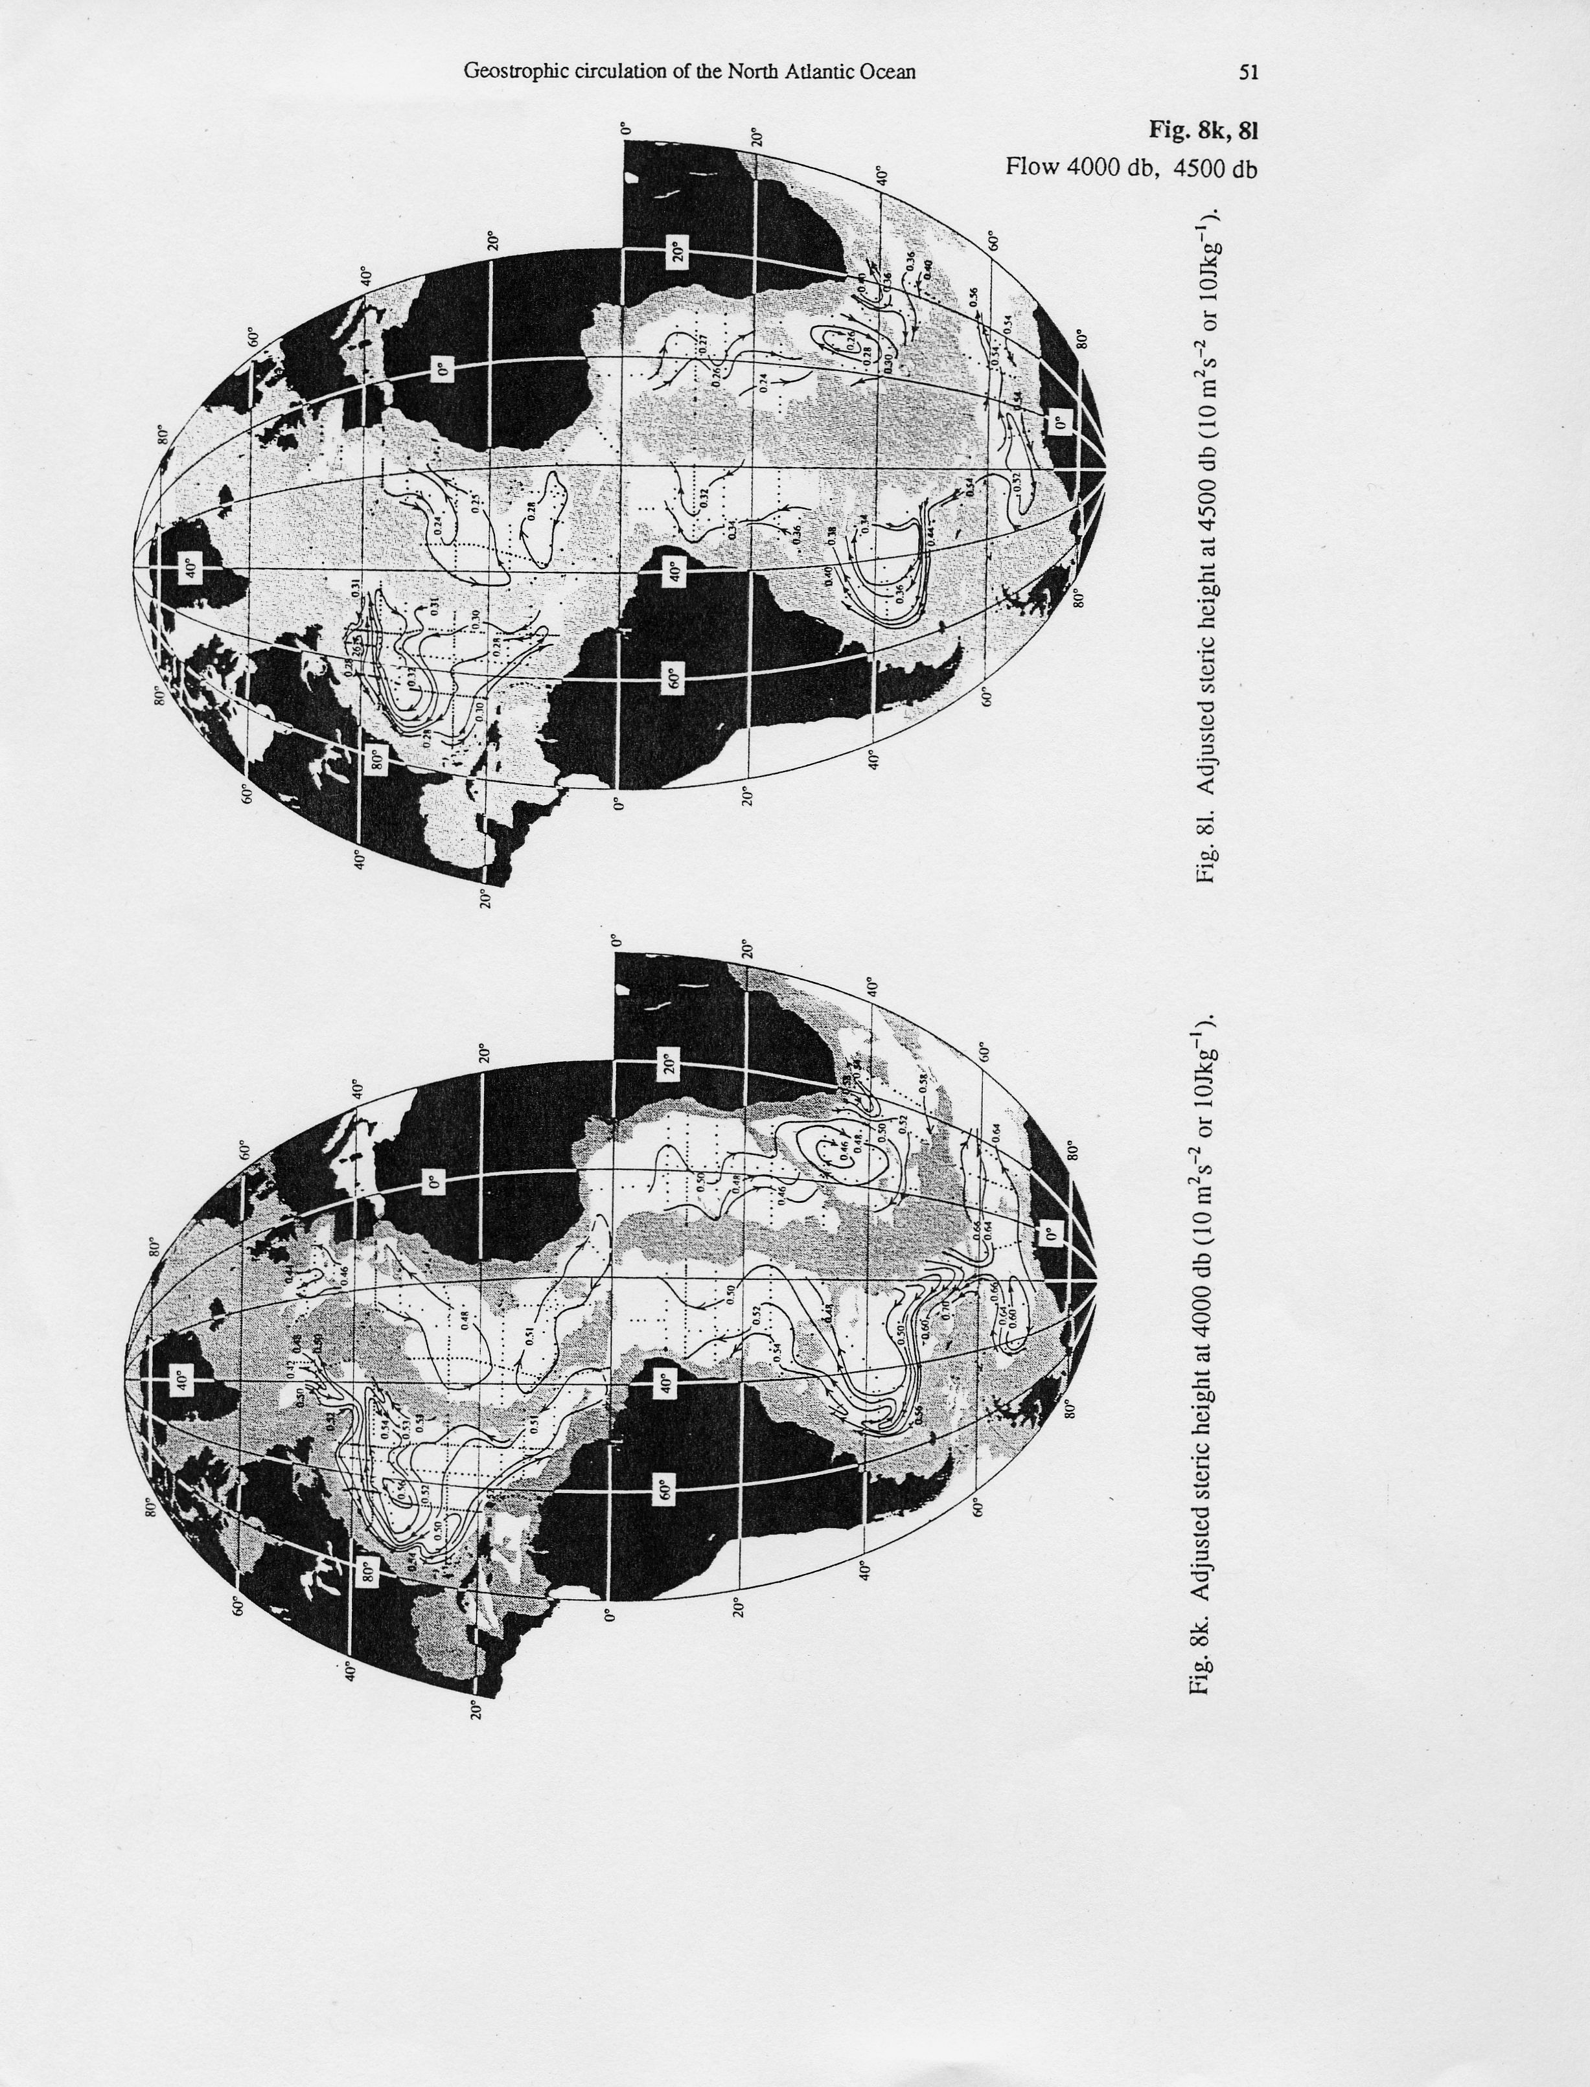
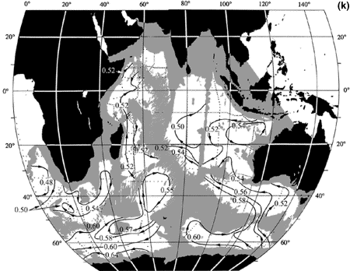
Circulation at 4000 dbar (adjusted steric height)
4000 dbar
Below depth of NADW in S. Atlantic
Dominated by topography. Deep Western Boundary Currents, deep cyclonic flows in some isolated basins
Notes:
DWBCs
Atlantic: below NADW level so S. Atlantic dominated by AABW northward flow
Interior cyclonic flows very rare - flows entirely associated with topography in interior, also very weak

Slide 10
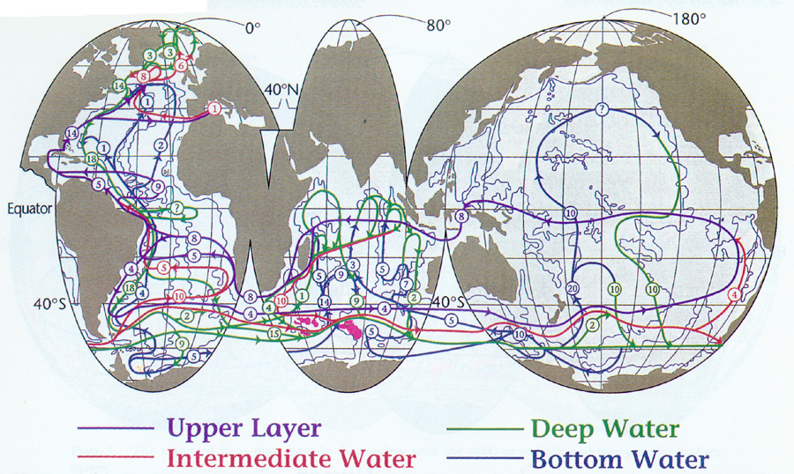
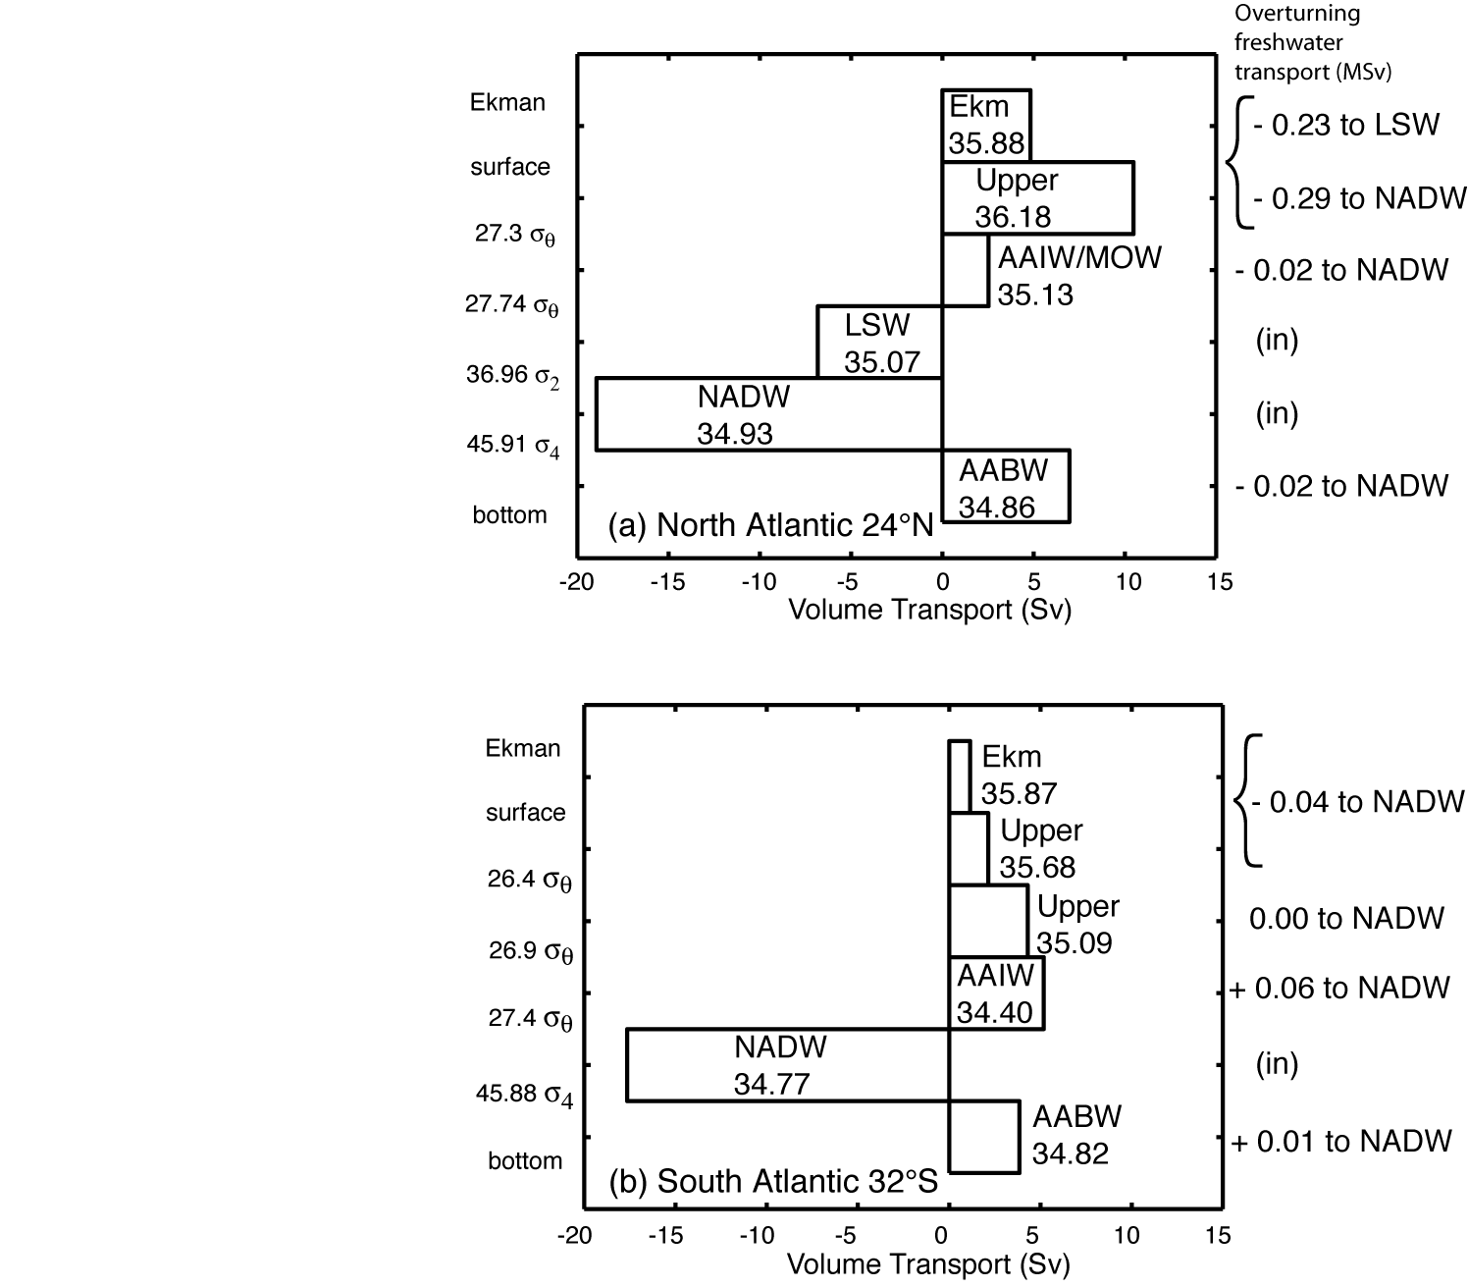
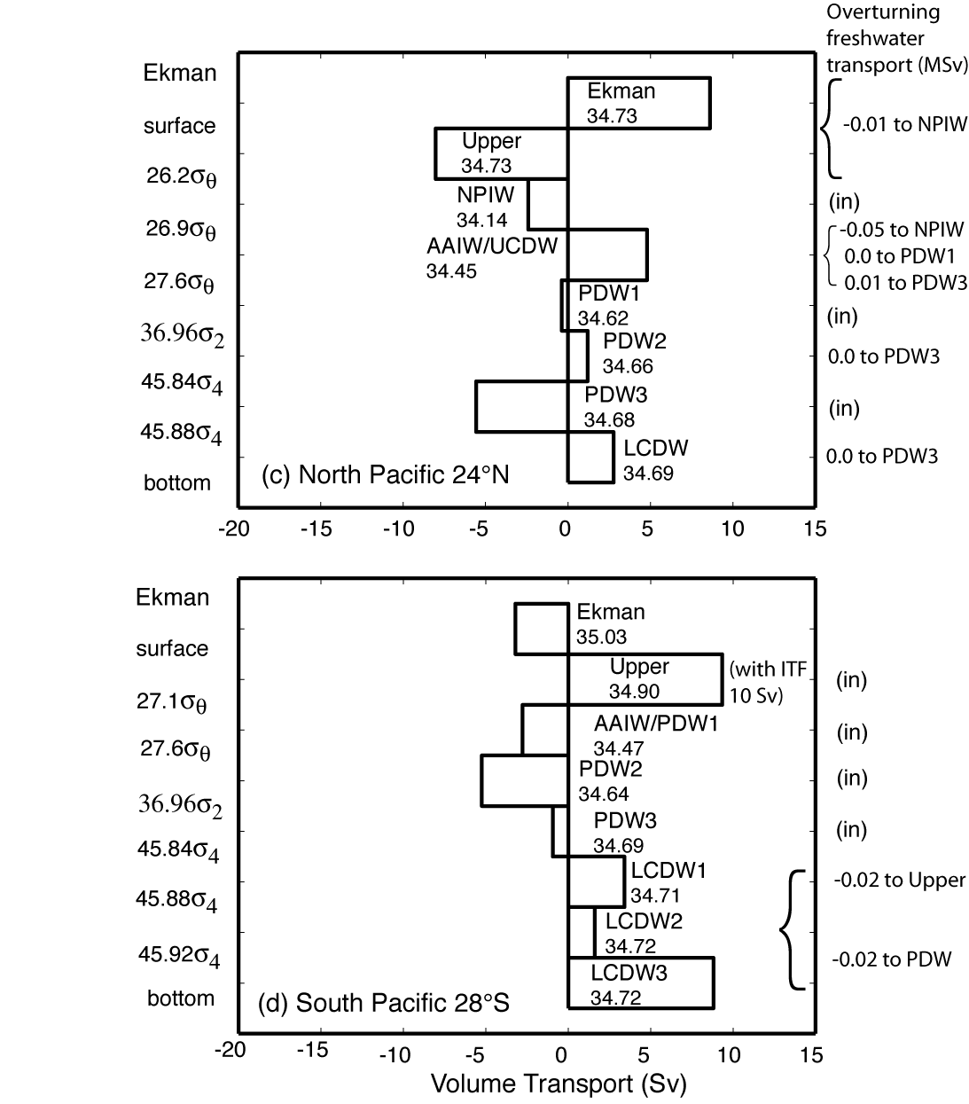
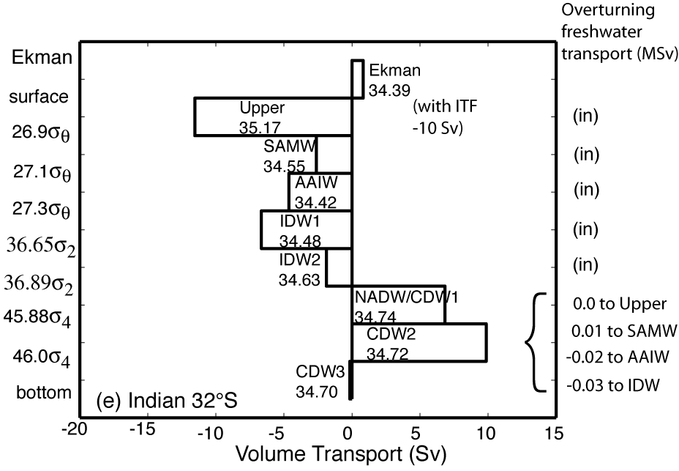
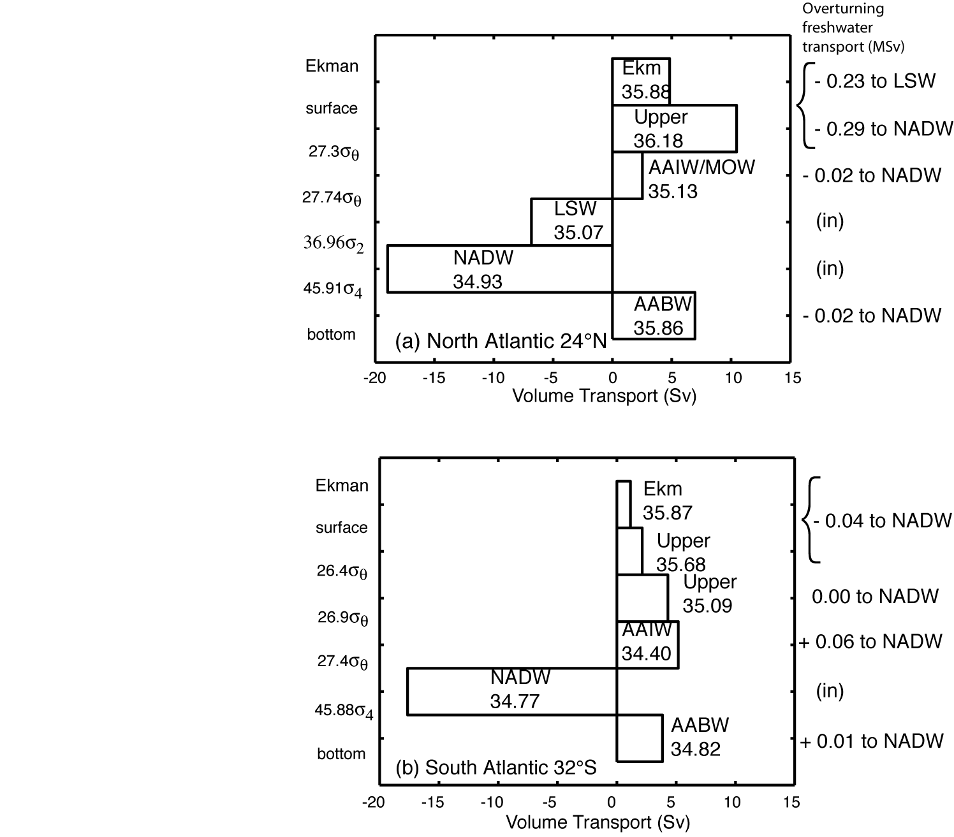
Net meridional transports in isopycnal layers

Slide 11
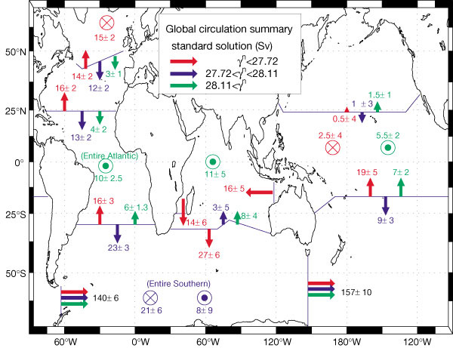
Global mass transport (Ganachaud and Wunsch, 2000)

Slide 12
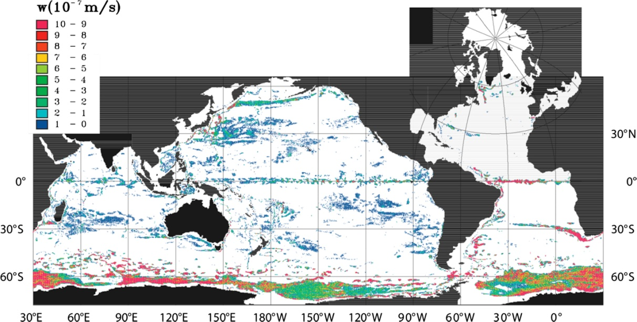
Vertical velocities (model result)
Modeled upwelling across the isopycnal 27.625 kg/m³, which represents upwelling from the NADW layer. This figure can also be found in the color insert.

Slide 13
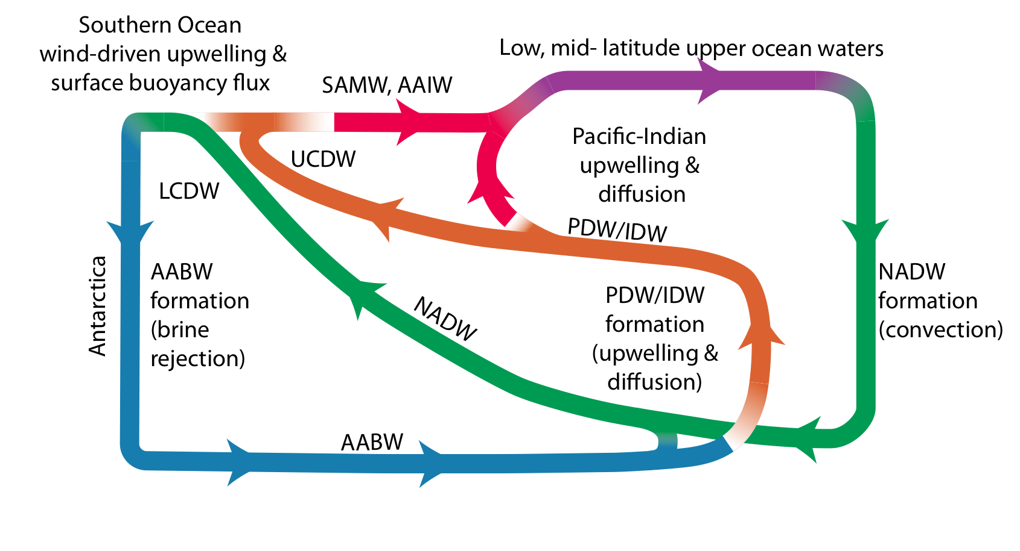
Global overturning in zonally-averaged view

Slide 14
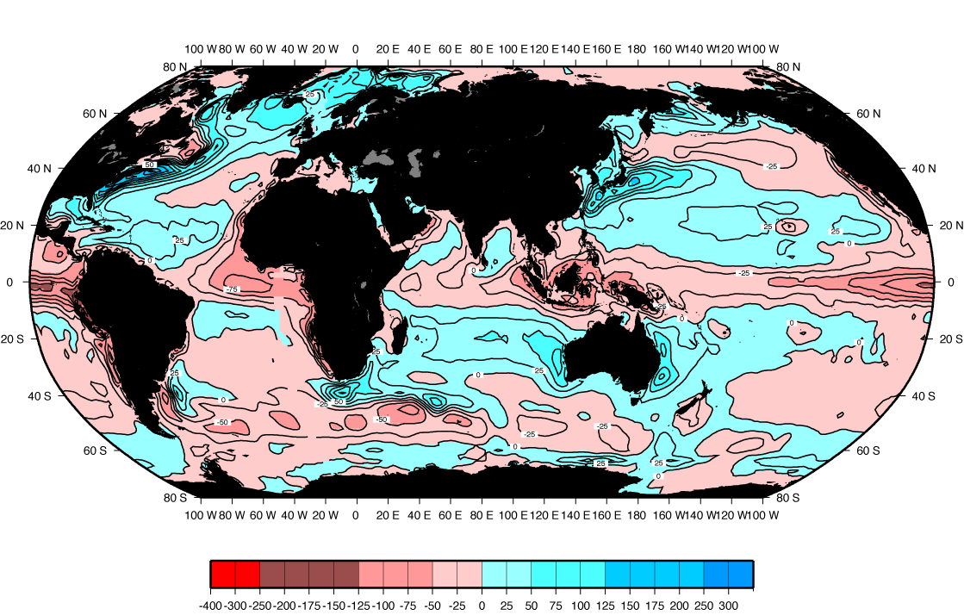
Heat transported by ocean circulation (big arrows)
Air-sea heat flux: Red shading - ocean gains heat. Blue - ocean loses heat.

Slide 15
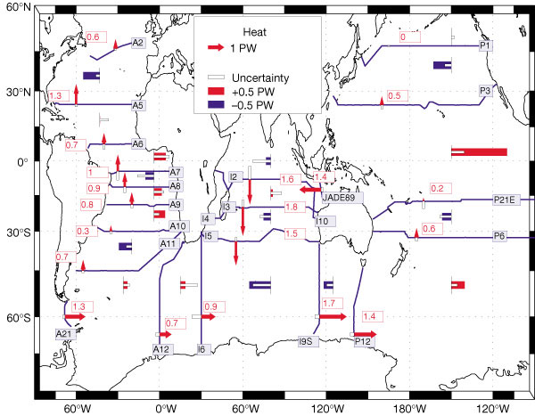
Global heat transport (Ganachaud and Wunsch, 2000)

Slide 16
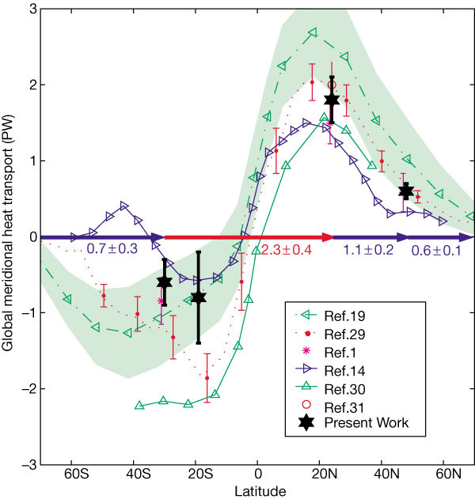
Global heat transport (Ganachaud and Wunsch, 2000)

Slide 17
Water mass review: 4 layer view of the global ocean
Upper layer: ventilated thermocline. Includes Mode Waters, Central Water, subtropical Underwater (salinity maximum water)
Intermediate layer: Labrador Sea Water, Mediterranean Overflow Water, Red Sea Water, North Pacific Intermediate Water, Antarctic Intermediate Water
Deep layer: North Atlantic Deep Water, Pacific Deep Water (also known as Common Water), Indian Deep Water, Circumpolar Deep Water
Bottom layer: Antarctic Bottom Water (aka Lower Circumpolar Deep Water)

Slide 18
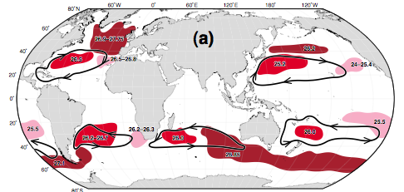
(1) Upper ocean water masses
Central Waters (main subtropical thermocline, derived from broad subduction of subtropical surface waters) (not illustrated here)
Subtropical Underwater (ST gyre, shallow salinity maxima, derived from subduction of saltiest ST surface water) (not illustrated here)
Mode Waters (upper ocean, thick layers) (figure)

Slide 19
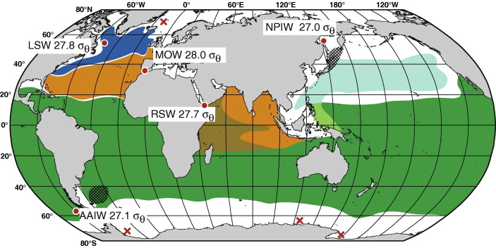
(2) Intermediate water summary
Low salinity: Labrador Sea Water, North Pacific Intermediate Water, Antarctic Intermediate Water
High salinity: Mediterranean Water, Red Sea Water

Slide 20
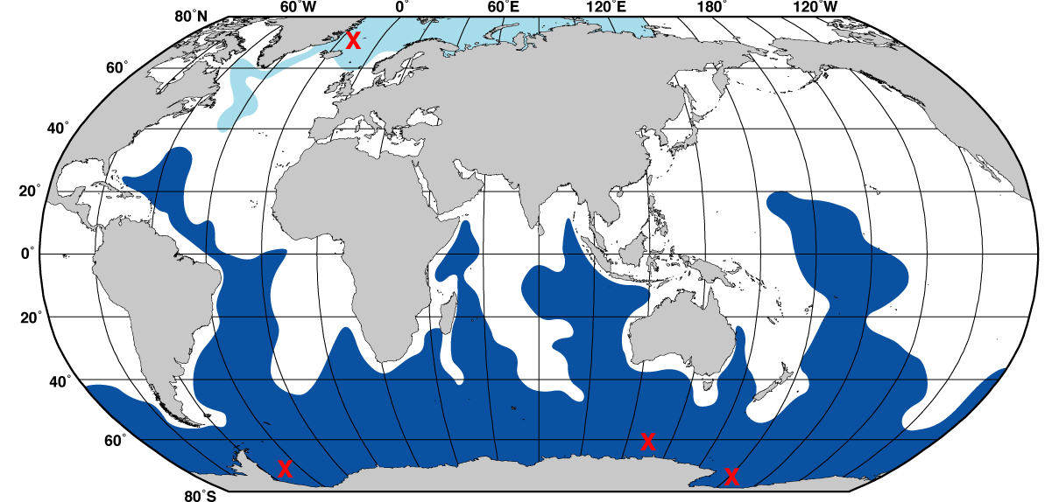
(3, 4) Deep water partial summary
(3) Nordic Seas Overflow waters, contributing to NADW
(4) Antarctic Bottom Water in Weddell, Ross Seas and Adelie Coast

Slide 21
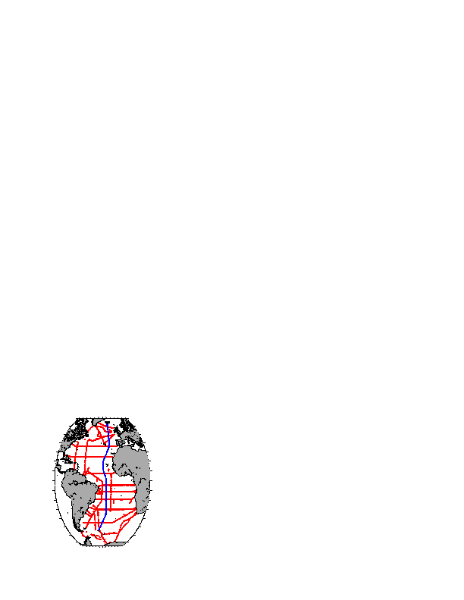
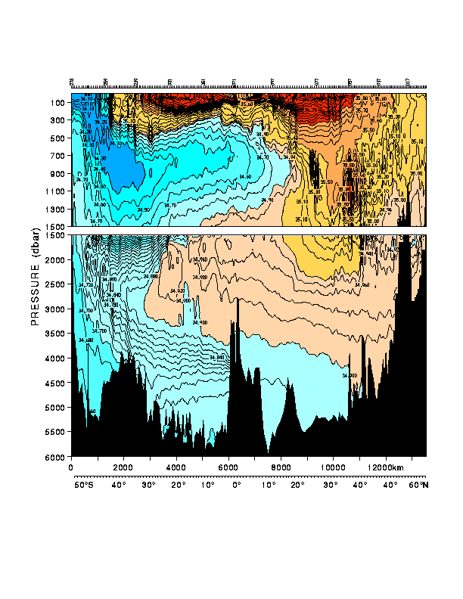
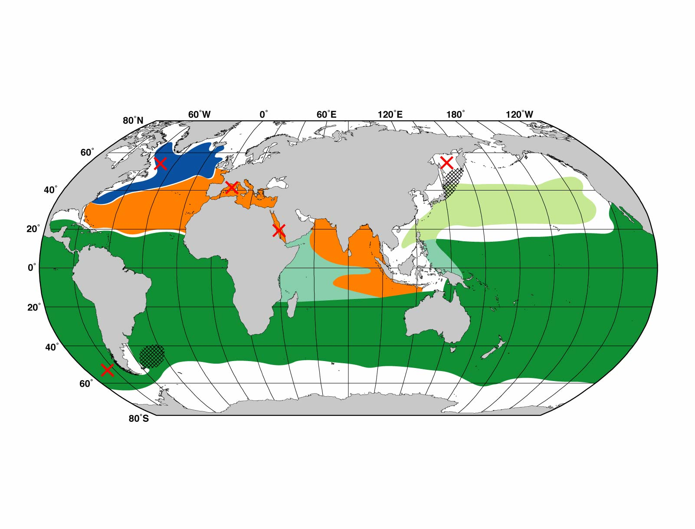
Atlantic Salinity (south-north section)
(1) surface waters (ventilated thermocline)
(1)
(2) Low salinity Antarctic intermediate water
(2)
(3)
(3) High salinity
North Atlantic Deep Water
(4)
(4) Low salinity Antarctic bottom water
30°S
24°N

